Slide 1
HOUSING: PRICE PREDICTION
A case study from the "Surprise Housing" housing enterprise in the United States. The organization is looking for homes to acquire for less than their true value and resale for a profit, allowing it to enter the real estate market.
Submitted by Anubhav Saxena
Data Science Intern
Flip Robo Technologies

Slide 2
ACKNOWLEDGMENT
I'd want to thank Shubham Yadav, my SME (Subject Matter Expert), and Flip Robo Technologies for enabling me to work on this project on housing price prediction and assisting me in performing comprehensive research that allowed me to learn a lot of new things.
In addition, I used a few outside resources to help me finish the project. I made sure to learn from the samples and adjust things to fit my project's needs.

Slide 3

HOUSING SALE PRICE PREDICTION PROJECT

Slide 4
INTRODUCTION
Surprise Housing is a real estate and housing firm established in the United States that is attempting to break into the Australian real estate market. The firm is seeking for potential properties to purchase in order to enter the market. We must use Machine Learning to create a model that will estimate the real worth of the potential properties and help us decide whether or not to invest in them.
Surprise Housing is curious about the following:
1. What factors are crucial in predicting the sale price of a home?
2. How do these feature variables relate to the house's price?

Slide 5
AGENDA
Analytical Problem Framing
Exploratory Data Analysis (EDA)
Visualizations
Data Pre-Processing on train and test datasets
Model/s Development and Evaluation
Performing hyper parameter tuning, saving the best model and predicting the label
Conclusion and future work discussion

Slide 6
Hardware - Software Requirements and Tools Used
Hardware Used:
RAM: 8 GB
Processor: Intel(R) Core(TM) i3-7100U CPU @ 2.40GHz 2.40 GHz
Software Used:
Programming language: Python
Distribution: Anaconda Navigator
Browser based language shell: Jupyter Notebook
Libraries/Packages Used:
Pandas, NumPy, matplotlib, seaborn, scikit-learn and
pandas_profiling

Slide 7
PROBLEM STATEMENT
Houses are a basic requirement for everyone on the planet, thus the housing and real estate sector is one of the most important contributors to the global economy. It's a huge market with a lot of different firms operating in it.
Data science has emerged as a critical tool for firms to employ to address challenges in the sector, such as increasing total income and profitability, enhancing marketing methods, and focusing on shifting trends in home sales and purchases.
Machine learning approaches like as predictive modelling, market mix modelling, and recommendation systems are employed by housing firms to achieve their business objectives. One such housing firm is the source of our difficulty.

Slide 8
ANALYTICAL PROBLEM FRAMING
Due to the fact that we are given two sets of data, one for training and the other for testing. We'll use the train dataset to develop a machine learning model, and then use that model to generate predictions for the test dataset.
Both datasets are in csv format, with 1168 rows and 81 columns for the train dataset and 292 rows and 80 columns for the test dataset. We don't know the target label in the test dataset, so we'll have to guess.
And, because this is a continuous data problem, I'll be utilizing several regression machine learning models to estimate house selling prices.

Slide 9
DATA ANALYSIS - MODEL BUILDING FLOWCHART
Import Dependencies or Libraries
Data preprocessing
Checked for Null Values
Data set Collection
Checked for Outliers/Skewness
Checked for correlation
Encoding
EDA and Visualization
Proceed for Model building
R2 Score, Cross Validation Score, MSE, RMSE, MAE
Hyper Parameter Tuning
Saving the Final Model

Slide 10
DATA PRE PROCESSING
Importing the necessary dependencies and libraries.
Reading the CSV file and converted into data frame.
Checking the data dimensions for the original dataset.
Looking for null values and accordingly fill the missing data.
Checking the summary of the dataset.
Checking unique values.
Checking all the categorical columns in the dataset.
Visualizing each features using matplotlib and seaborn.
Performing encoding using the ordinal encoder on categorical features.
Checking for co-relation/multi-collinearity in a heatmap.
Checking for Outliers/Skewness using boxen plot and distribution plot.
Perform Scaling using Standard Scaler method.
Checking for the final dimension of dataset to confirm the input details.
Creating train test split and the best random state found in the range 1-1000.

Slide 11
EXPLORATORY DATA ANALYSIS (EDA) AND VISUALIZATION
1. Univariate Analysis
The most basic type of data analysis is univariate analysis. Because "uni" implies "one," your data only contains one variable.
2. Multivariate Analysis
Multivariate analysis is a collection of statistical approaches for analyzing data with several variables.
3. Correlation of Dataset
Correlation is a statistical method for determining whether or not two quantitative or categorical variables are related.
4. Correlation with Target variable
To figure out how the data is connected, use correlation with the target variable.
5. Conclusion
The result of all of the analysis is summarized in this section.

Slide 12
PIE PLOT
A Pie Chart is a circular statistical layout that can only show one set of data at a time.
The overall percentage of the provided data is represented by the chart's area.
The proportion of sections of the data is represented by the area of the pie slices.

Slide 13
COUNT PLOT
The count plot approach uses bars to represent the counts of data in each category bin.
Parameters: This technique takes the following parameters, which are listed below: x, y
This parameter accepts the names of data variables or vector data as optional inputs when graphing long-form data.

Slide 14
SCATTER PLOT
Scatter plots are used to visualize the relationship between variables, with dots representing the association.
A scatter plot is created using the matplotlib library's scatter function.
Scatter plots are commonly used to depict the relationship between variables and how one impacts the other.

Slide 15
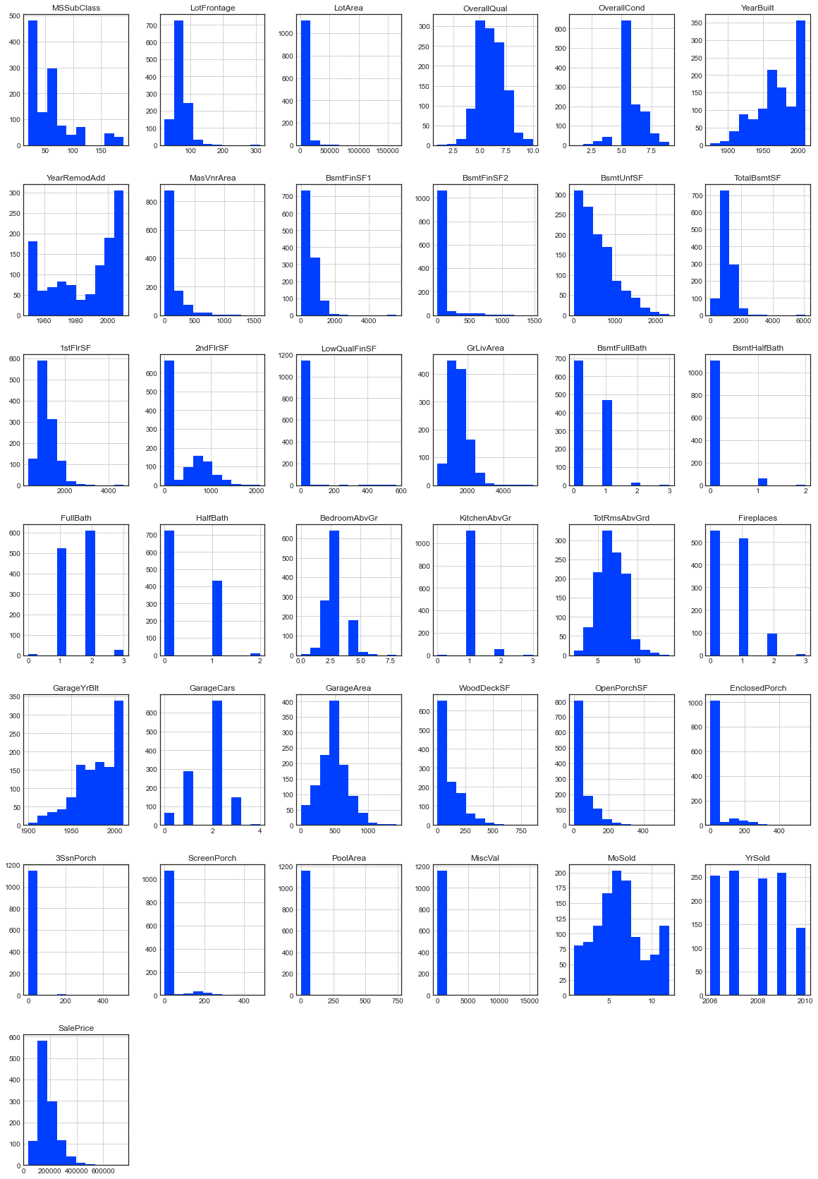
HISTOGRAM
A histogram is a visual representation of data presented in the form of groupings.
It is a precise approach for displaying numerical data distribution graphically.
It's a sort of bar plot in which the X-axis shows bin ranges and the Y-axis represents frequency.

Slide 16
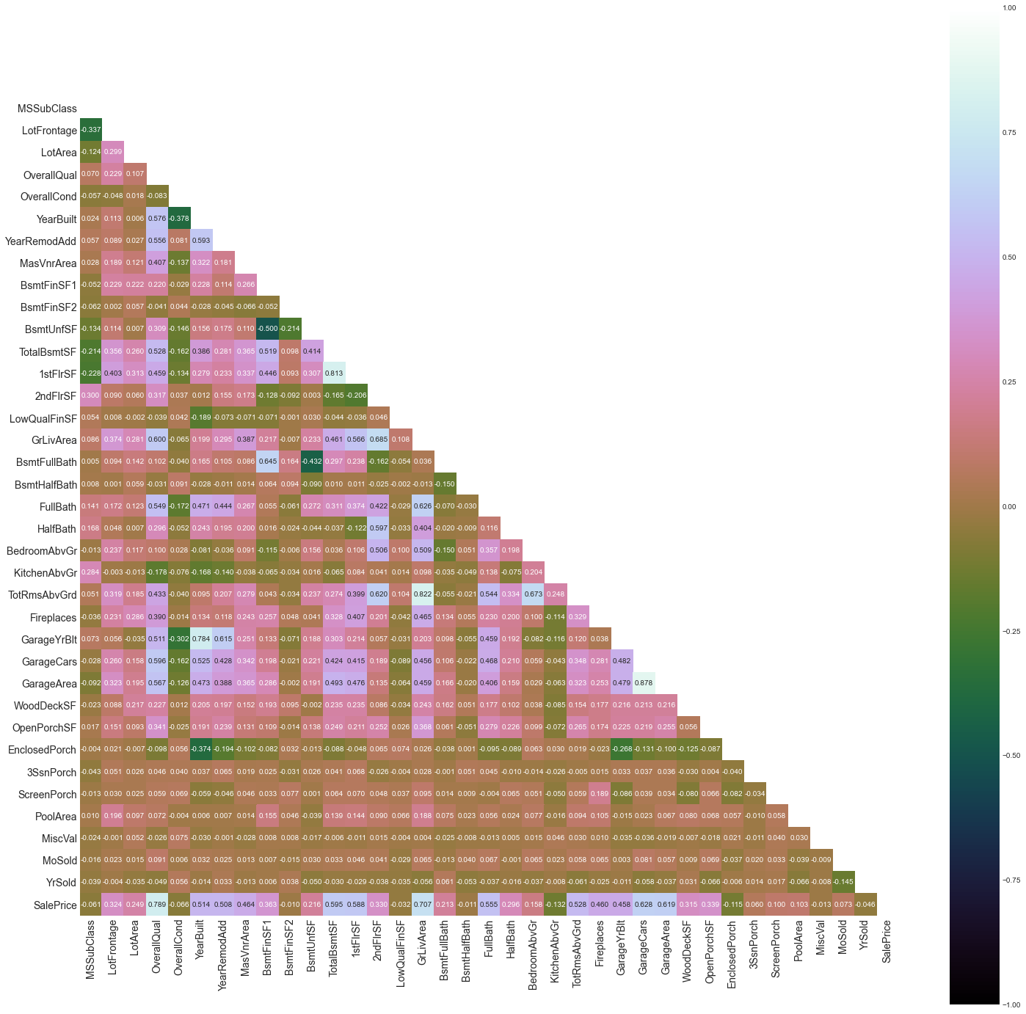
HEATMAP
For each value to be plotted, a heatmap has values indicating several shades of the same hue.
The deeper hues of the chart usually correspond to greater values than the lighter shades.
A entirely different hue can likewise be utilized for a significantly different value.

Slide 17
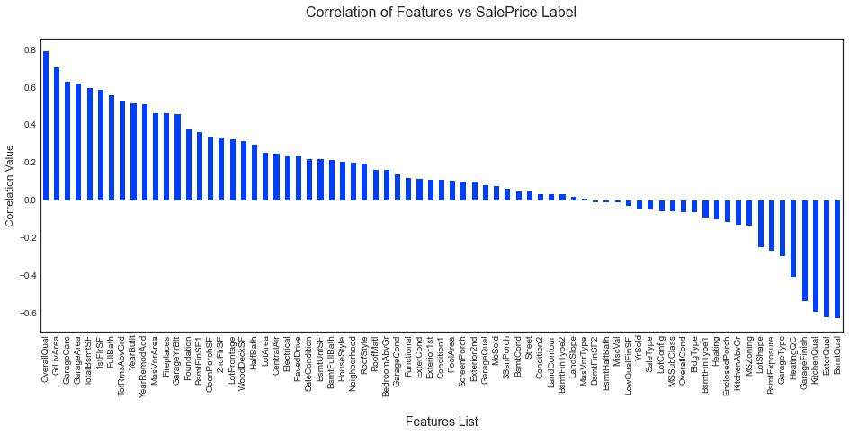
BAR GRAPH
Bar graphs are used to compare two groupings of data or to follow changes over time.
In this case, the correlation values between the feature columns and the target label column, which is Sale Price in our instance, are being compared.
It reveals the information of positive and negative associated columns.

Slide 18
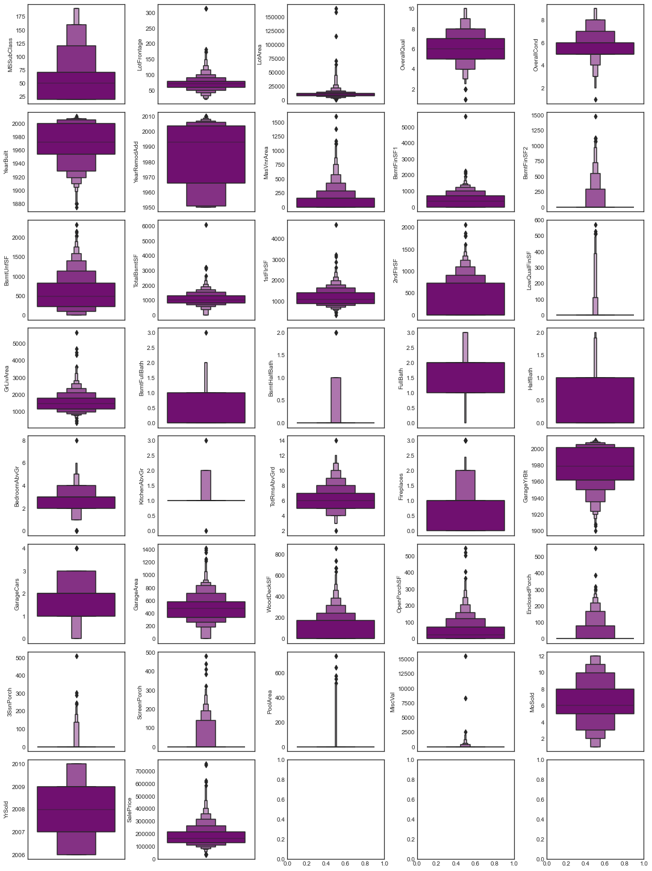
BOXEN PLOT
A Boxen Plot, also known as a Whisker Plot, is used to show a summary of a group of data values that include attributes such as minimum, first quartile, median, third quartile, and maximum.
We utilized it to find outlier information for all numeric datatype column values.

Slide 19
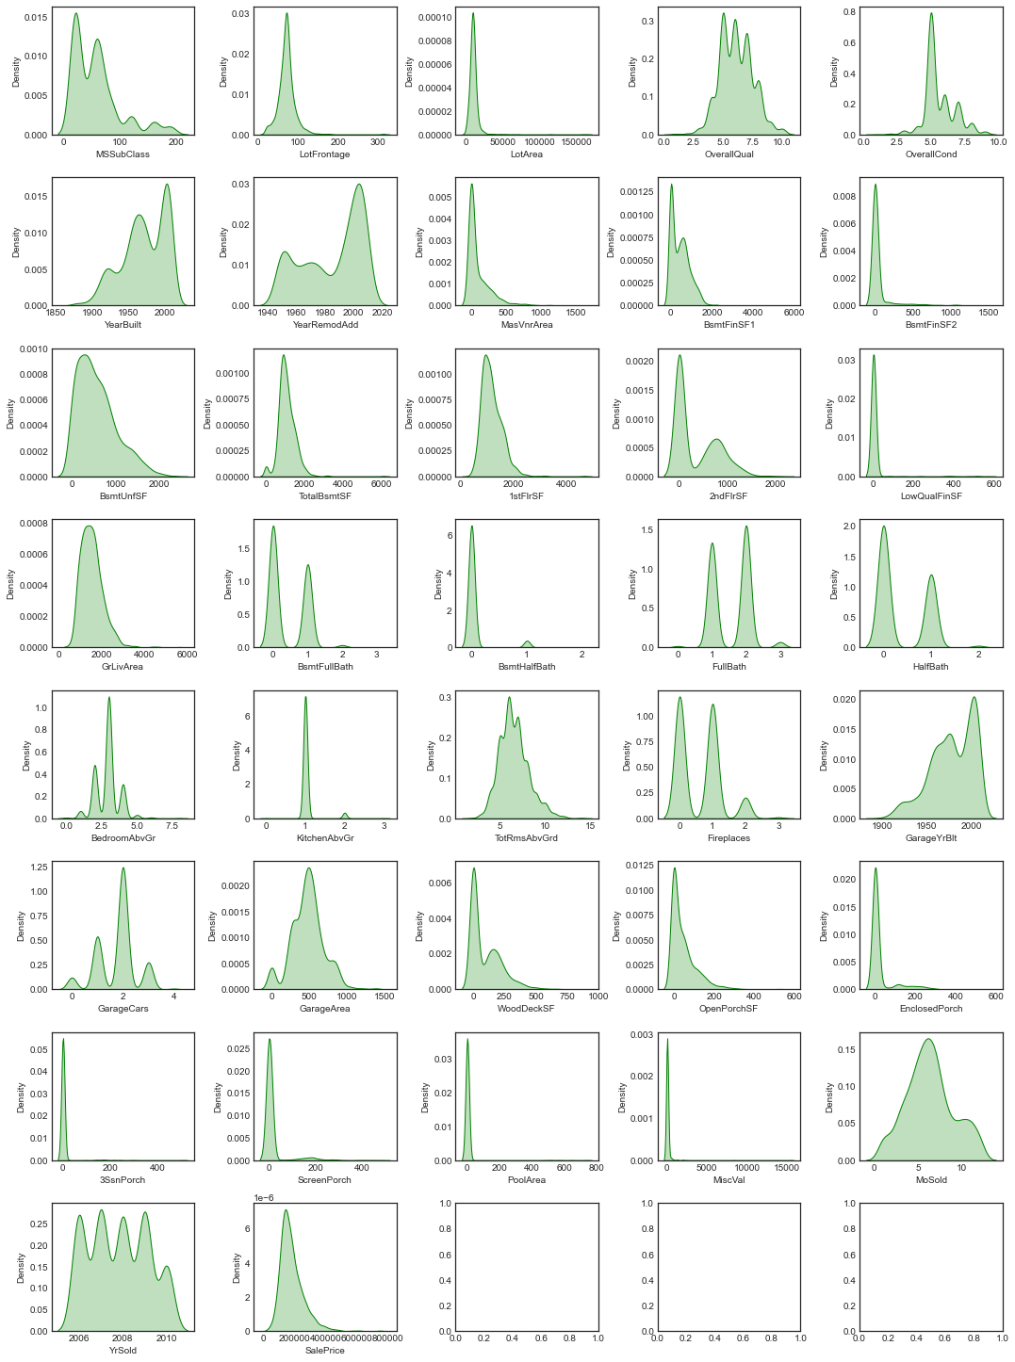
DISTRIBUTION PLOT
Distribution plots compare the empirical distribution of sample data with the theoretical values anticipated from a specific distribution to visually analyze the distribution of sample data.
It was utilized to examine the skewness information for numeric datatype column values in this case.
A normal distribution resembling a bell shape curve is typically suitable.

Slide 20
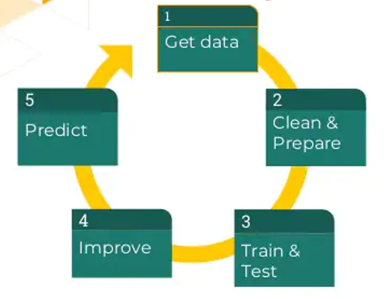
MODEL TRAINING PHASES

Slide 21
MODEL/S DEVELOPMENT
The algorithms used on training and test data are as follows:
Linear Regression Model
Ridge Regularization Regression Model
Lasso Regularization Regression Model
Support Vector Regression Model
Decision Tree Regression Model
Random Forest Regression Model
K Nearest Neighbors Regression Model
Gradient Boosting Regression Model
Ada Boost Regression Model
Extra Trees Regression Model

Slide 22
EVALUATION AND HYPER PARAMETER TUNING
The following were the primary metrics utilized in this study:
R2 score
Cross Validation Score
MAE
MSE
RMSE
Using Hyperparameter Tuning, we sought to discover the optimal parameter list to improve our accuracy ratings.
We utilized the Grid Search CV technique with 5 folds to attain a higher score.

Slide 23
CONCLUSION AND SCOPE FOR FUTURE WORK
Throughout this research, I ran into a difficulty with a lack of data to train machine learning models on.
Many columns have the identical data in more than 80% of the rows, causing our model's performance to suffer.
Another difficulty is that this data collection has a big number of missing values, thus we must manually fill those missing values in the proper manner.
With some feature engineering and rigorous hyperparameter adjustment, we can still enhance the accuracy of our model.

Slide 24
Thank You
For Your Attention

